Slide 1

Computers Principles
1-2 Lecture/ Introduction of Computers
Civil Engineering Department
College of Engineering / Diyala University/ 2015-2016.
Dr. Qasim Adnan Aljanabi

Slide 2
Q1: Draw the major Hardware parts diagram in computer system?

Slide 3
System Units
The system unit is the core of a computer system.
Usually it's a rectangular box, inside this box are many electronic components that process information.
The most important of these components is the Central Processing Unit (CPU), or Microprocessor.
Another component is Random Access Memory (RAM), which temporarily stores information that the CPU uses while the computer is on.

Slide 4
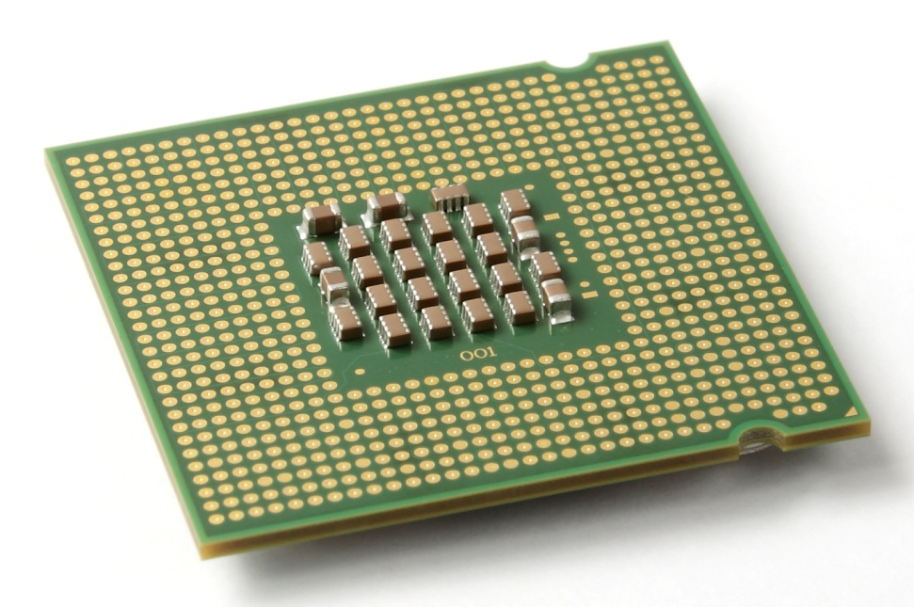
Central processing unit - cpu
CPU is the main circuit chip in computer; it performs most of the calculations necessary to run computer.
CPU speed measured by account of instructions that can execute in one secant, usually measured in (MHz).
CPU contents two units:
1. Control Unit (CU).
2. Arithmetic and Logic Unit (ALU).

Slide 5
Central processing unit - cpu
1. Control Unit (CU).
This unit control or supervised to all parts of computers such as:
Control operation of transfers data and instruction from input unit to memory and from memory to output unit.
Control operation of account executable instructions on ALU.
Basic work of CU is interpreter the instructions that is mean data oriented to specific location on ALU.
for example: if the instruction is (B+C) the B,C values transfers to (Adder) part, if the instruction is (BxC) the B,C values transfers to (Multiplier) part.

Slide 6
Central processing unit - cpu
2. Arithmetic and Logic Unit (ALU).
This unit executes the following operations:
Mathematical operations such as: add (+), abstract (-), multiplier (×), divide (÷).
Logical operations: this is basic to account comparisons to choose true or false specific case, such as >,< ,>=,<=,<>,= as a result of these comparisons specific instructions may be executable.
Merge number of simple comparisons by specific tools such as: AND, OR, NOT.

Slide 7
Main memory
Random Access Memory (RAM) the temporary storage area the computer uses to run programs and store data.
Information store in RAM is temporary and is designed to be erased when computer turn off.
RAM is a general indication of performance that is measured either in megabytes (MB) or gigabytes (GB): the larger the number, the faster some programs will run.
Memory is set of electronic circuit named (Cells), each cell store 0 or 1, like (on or off),the single cell content named (BIT) which represent basic unit in process data, because all data transfer to set of bits in digital computers.(BYTE) term for eight Bit: 1 Byte = 8 Bit

Slide 8
Memory capacity
Memory capacity units measured in kilo Byte which abstract by (KB) where: KB = 2¹⁰ Bytes = 1024 Bytes
In memories has large capacity measured in Mega Byte which abstract by (MB) where: 1 MB = 2²⁰ Bytes = 1048576 Bytes
In larger memories capacity measured in Giga Byte which abstract by (GB) where: 1 GB = 2³⁰ Bytes = 1073741824 Bytes
In largest memories capacity measured in Tiara Byte which abstract by (TB) where: 1 TB = 2⁴⁰ Bytes = 1099511627776 Bytes

Slide 9
Memory speed
Memory speed measured in WRITE speed where write mean translate data operations from CPU to main memory.
Also measured in READ speed where read mean translate data operations from main memory to CPU.
Read and write operations in memory named by Access.
Because read and write operations generated by CPU therefore memory speed equal almost CPU speed.

Slide 10
Types of Memory
1- Random Access Memory (RAM):
in this kind of memory can read and write on it generated by CPU.
This kind of memory used by user to store his programs on it.
This memory is temporary storage ends when the process is end or when split electric power.
2- Read Only Memory (ROM):
in this kind of memory can read only from it generated by CPU,
but cannot write on it from this unit because store specific computer system software on this kinds of memories, such as: BIOS, Start up Routine, Input/ output routine, Interpreter.
This memory do not miss it is contents where split electric power.

Slide 11
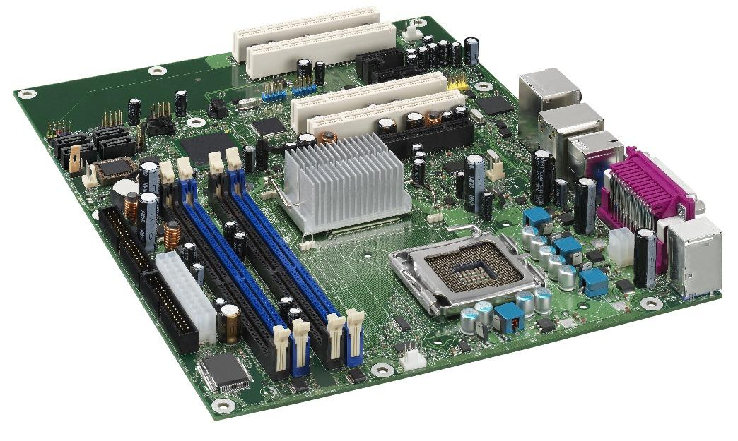
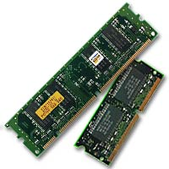
System board
The important part on computer loading: the CPU, memories, and control circuit.
It is allows to computer parts to exchange data to perform the required work, and coordinate computer parts, and memory organization.

Slide 12
bios & cmos
BIOS (Basic Input Output System):is a software that is built into computers and that is run when the computer first turn on.
Among other things this software starts the operating system and support transfer information between hard ware devices.
BIOS is part of your computer's hardware and is separate from Windows.
Complementary metal-oxide semiconductor, or CMOS, typically refers to a battery-powered memory chip in your computer that stores start-up information.
Your computer's basic input/output system (BIOS) uses this information when starting your computer.

Slide 13
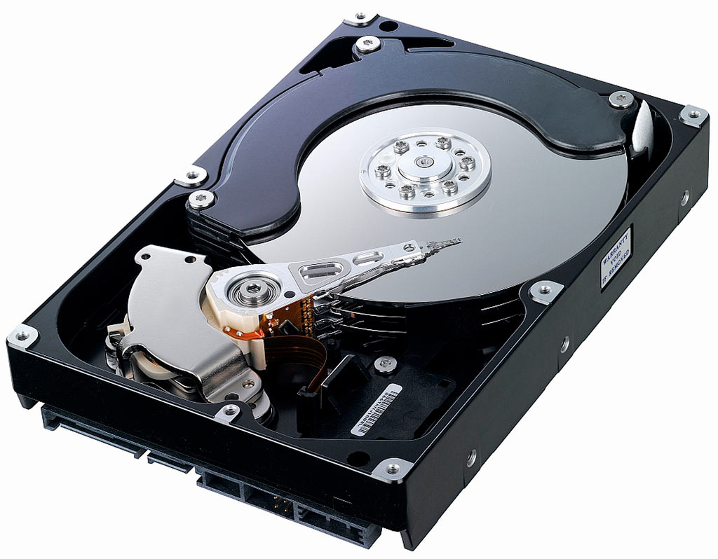
Storage units
1- Hard Disk Drive
Your computer's hard disk drive stores information on a hard disk—a rigid platter or stack of platters with a magnetic surface.
The hard disk drive is normally located inside the system unit.

Slide 14
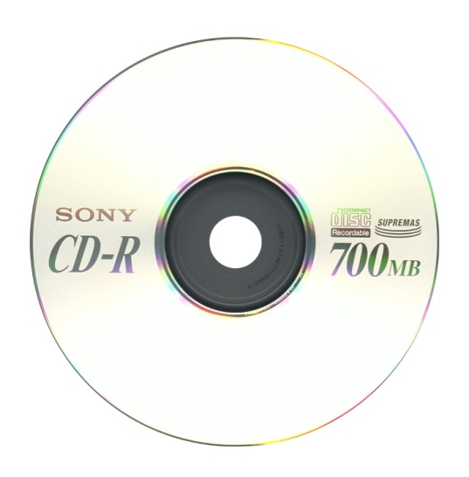
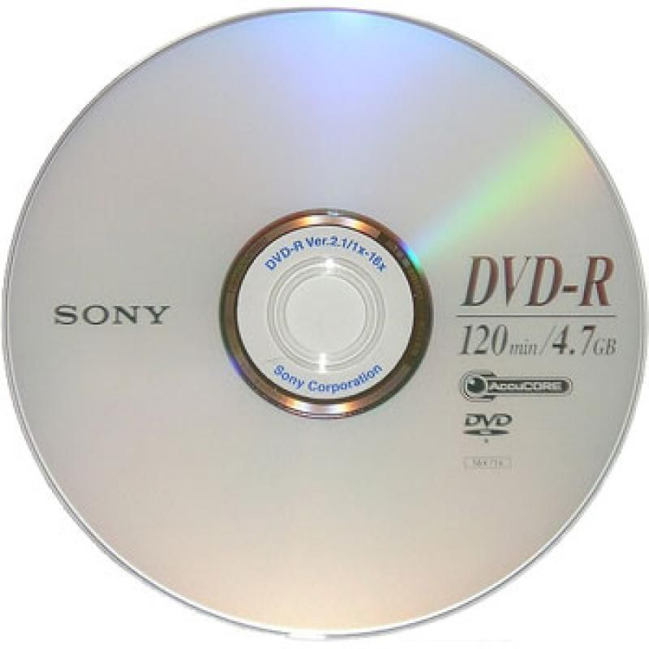
Storage units
2- CD and DVD Drives
CD drives use lasers to read (retrieve) data from a CD; many CD drives can also write (record) data onto CDs.
If you have a recordable disk drive, you can store copies of your files on blank CDs.
CD storage capacity less than 1GB.
DVD drives (Digital Video Disk) can do everything that CD drives can, plus read DVDs.
If you have a DVD drive, you can watch movies on your computer.
Many DVD drives can record data onto blank DVDs.DVD storage capacity may be 17 GB.

Slide 15
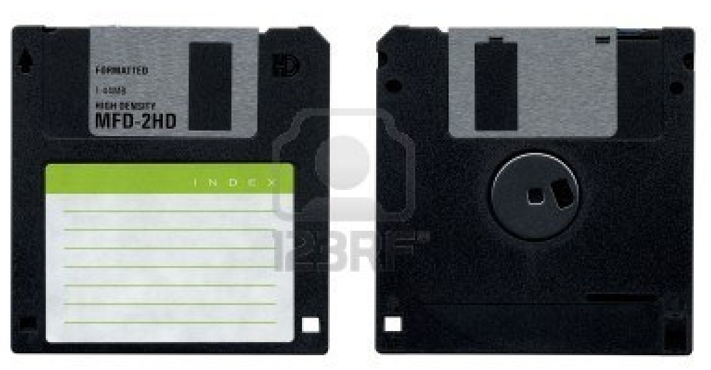
Storage units
3- Floppy Disk Drive
Floppy disk drives store information on floppy disks, also called floppies or diskettes.
Compared to CDs and DVDs, floppy disks can store only a small amount of data. They also retrieve information more slowly and are more prone to damage.
For these reasons, floppy disk drives are less popular than they used to be, although some computers still include them.

Slide 16
Computer software
Software refers to the instructions, or programs, that tell the hardware what to do.
Programs set of instructions that a computer uses to perform specific task such as word processing accounting or data management also called an application.
Software includes:
1. Low Level Language: this language includes:
• Machine Language: the instructions input to computer must be written in binary system i.e.by [0,1] the unique language that computer understand .it is very complex.
• Assembly Language: this language used simple words such as [Jumb,Add,Move, Sub] this lead to simplify computer using.

Slide 17
Computer software
2. High Level Language:
the data and instruction using symbols and numbers and words written in language similar to human language.
Each language has it is specific grammar.
Example of these language: BASIC,FORTRAN,COBOL, PASCAL, PL/1, ADA, RPG, LISP, FORTH, SNOBOL, APL, ALGOL, LOGO.
3. Translation Programs:
these programs transfer high level language or assembly language to machine language, these programs include:
• Assembler: program transfer the program written in assembly language to machine language.

Slide 18
Computer software
• Compiler:
program transfer high level language programs to machine language program,
the program written in high level language named Source Program, after transfer it to machine language by compiler is named Object Program.
When using compiler in transfer operation, cannot execute the program unless complier all program sentences end.
• Interpreter: program written in machine language and store in ROM memory, it is work similar to compiler but differ from it where is compiler program sentences immediately.

Slide 19
Computer software
4. Operating System: program that manages all computer parts. The operating system allows you to use software programs, and coordinate the use of computer hardware (such as the keyboard and mouse).
Operating System Types:
1. Single user Operating System: by these systems can execute on program in one using one personal computer, MS.DOS example of this kind of operating system.
2. Multi Tasking Operating Systems for Single User: by these systems the user can use the personal computer to execute different types of programs in the same time, WINDOWS example of this kind of operating system.
3. Multi user Operating Systems: these operating system apply on many types of computers linked together, by these systems different users can use many computers in the same time, such as UNIX operating system.

Slide 20
Files organization
While you're working with a file in a program, you should save it frequently to avoid losing data unexpectedly due to a power failure or other problems.
Files typically have a three letter file name extension that helps to indicate type.

Slide 21

Questions - ?

